Slide 1
OBJECT ORIENTED PROGRAMMING-OOP CS217
Engr. Mashal Khan
mashal.khan@nu.edu.pk

Slide 2
Pre Requisites & Assessments
Intro to programming
Assessments | Weightage
Assignments | 10%
Quizzes | 10%
Sessionals | 15%
Finals | 40%
Term Project | 10%

Slide 3
Introduction to OOP
Divide and Rule approach.
Divide complex problems into smaller problems.
Class based.
Objects that can interact with each other.
Ease in development.
C++, C#,Python, Java

Slide 4
Popular Concepts
Classes, Prototypes- Template
Objects – Instance of Class
Inheritance
Polymorphism
Encapsulation
Abstraction
Access Modifiers
Interfaces

Slide 5
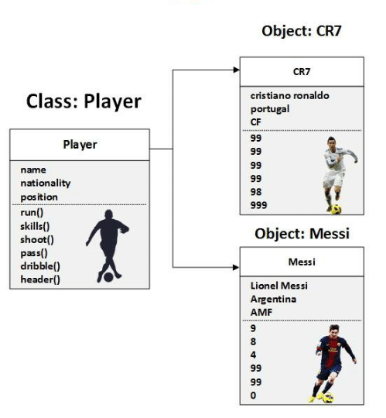

Slide 6
Features Why OOP?
Problem solving easier
Reusability
Ease in programming
Ease in debugging
Secure
Easy to add or remove stuff.

Slide 7
OOP V/S Structured Programming
Structured Programming | Object Oriented Programming
Focus on Process | Focus on Data
Top Down Approach | Bottom Up Approach
Functions | Objects
Less reusability | Reusable
High Dependency | Low dependency
Hard to modify | Easy to modify
Less Abstraction and Feasibility | Abstraction and Feasibility
Complex Code | Complex Design

Slide 8
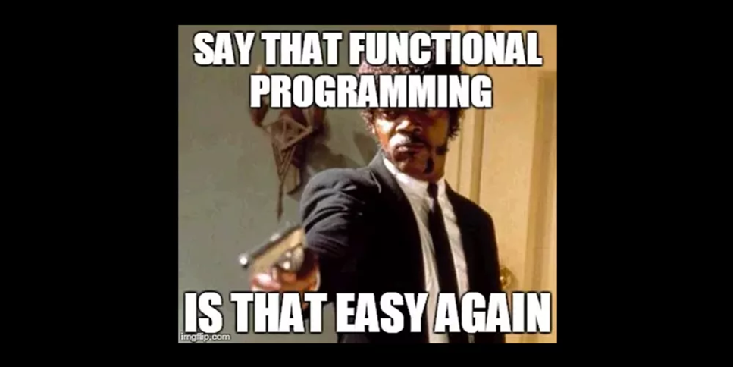

Slide 9
Suggested Programming Style
OOP Approach
Multiple Header files
Link them to main file.
Avoid lengthy and messy codes
Proper comments and Indentation
Use of flow charts and Pseudo codes.
Notes:
Meaningful names

Slide 10
Arrays
Store multiple but similar values in a single variable.
Variable type is defined.
Name specified.
Size and dimension of the array is specified.
Stored in a continuous memory location.
Name of the array act as pointer.
DataType ArrayName[Size]={Values};
Notes:
In C/C++, pointers and arrays are closely related. As you know, an array name without an index is a pointer to the first element in the array. For example, consider the following array.
char p[10];
The following statements are identical:
p
&p[0]

Slide 11
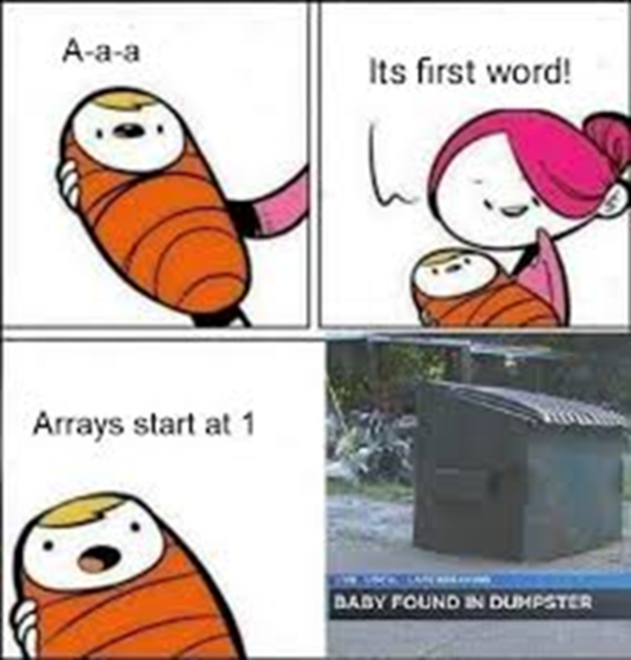

Slide 12
Multi-Dimensional Arrays
2D & 3D Arrays
Data stored in tabular form
DataType ArrayName[size1] [size2] [size3]………[sizeN];
Notes:
3D array= Images
2D arrays=Matrix

Slide 13
References
Reference to an existing variable.
& operator is used to create reference variables
& can also be used to get memory address of the variable.
string food = "Pizza"; string &meal = food;

Slide 14
Pointers
Variables pointing to memory addresses.
Int datatype as it stores addresses
Size= 4 bytes
Stores the memory address as its value.
* operator is used to create a pointer.
DataType *Ptr= Value;
DataType is same as that of the value it is pointing to.

Slide 15
string food = "Pizza";
string* ptr = &food;
cout << ptr // Prints address of food
cout << *ptr // Prints value stored i.e. Pizza
*ptr = "Hamburger"; // change pointer value

Slide 16
Reading Assignments
Various Programming Styles
Difference between them
Advantages and Disadvantages
List of Languages and Tools for each
References and Pointers

Slide 17
Topics of the Day
What is OOP?
Discussion on which approach is better and why?
Arrays
Reference Variables and Pointers

